Slide 1

PULSE GUARD
PITCH DECK
By LunaTek

Slide 2
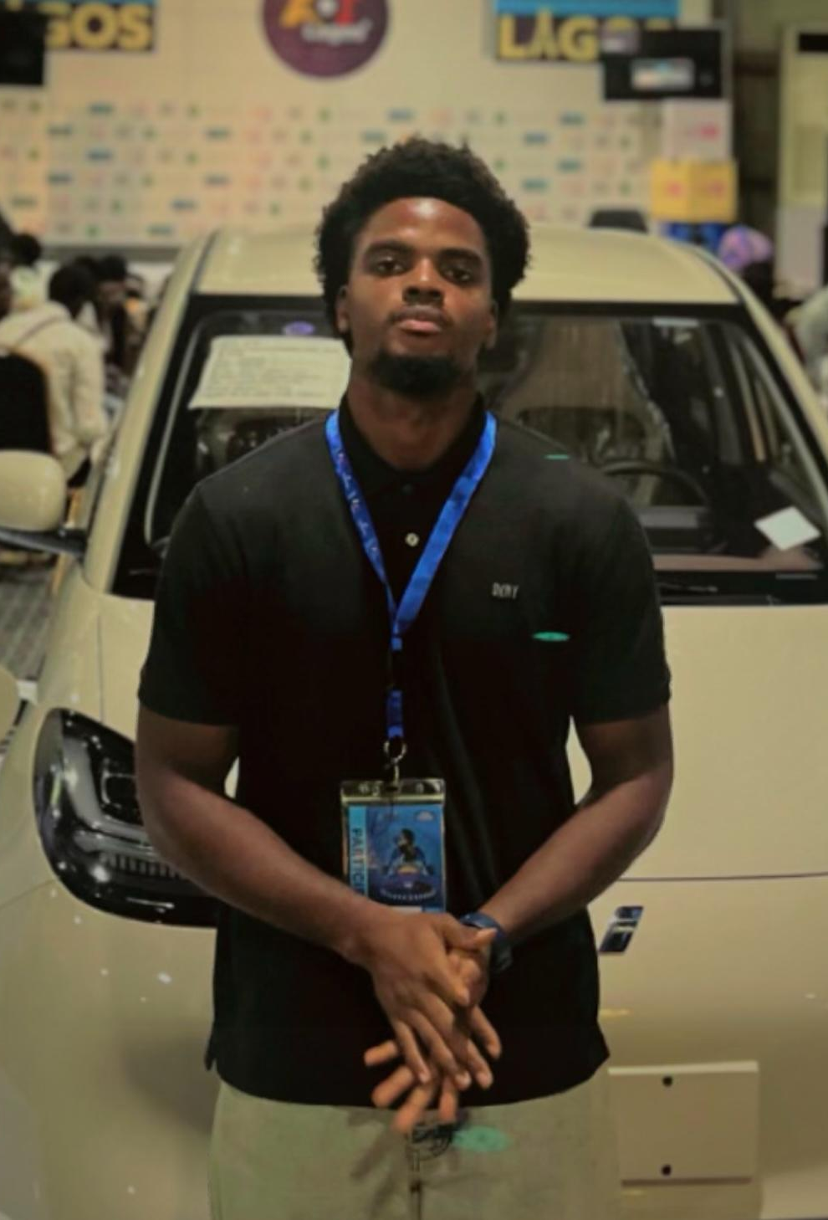

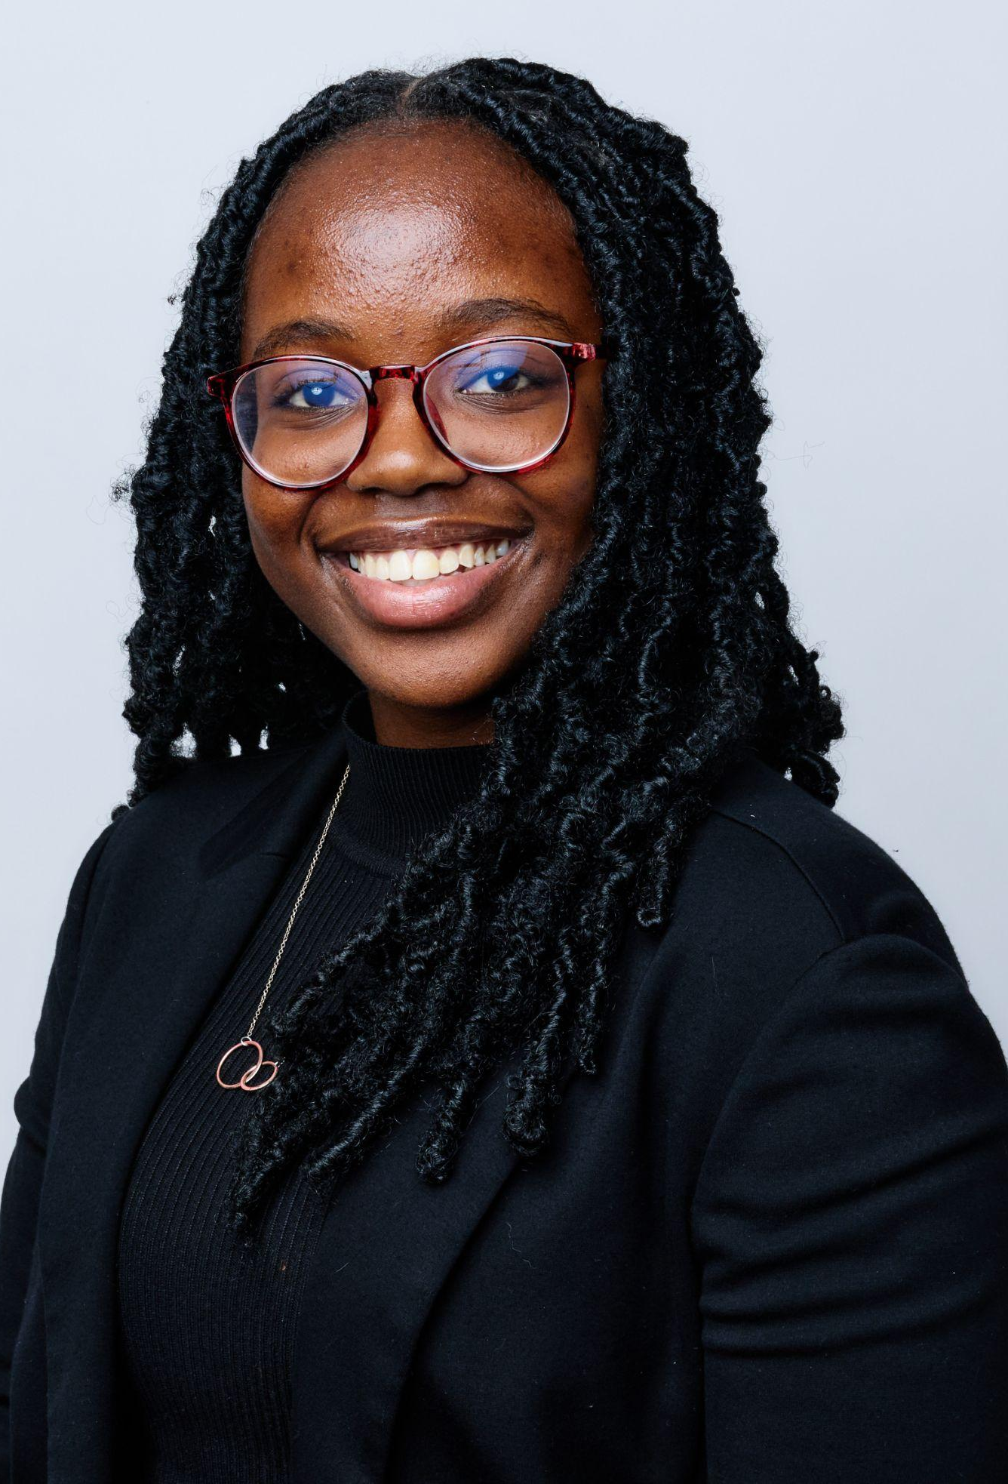
MEET THE TEAM
Dubem Onwuchuluba
Raquel Martin
Wambũi Gitahi

Slide 3
TABLE OF CONTENTS
01.
02.
03.
04.
05.
06.
INTRODUCTION
PROBLEM & SOLUTION
MARKET OPPORTUNITY
PRODUCT DEMO
TEAM & TIMELINE
FINANCIAL & METRICS

Slide 4

What if safety didn’t just wait for something to go wrong?

Slide 5
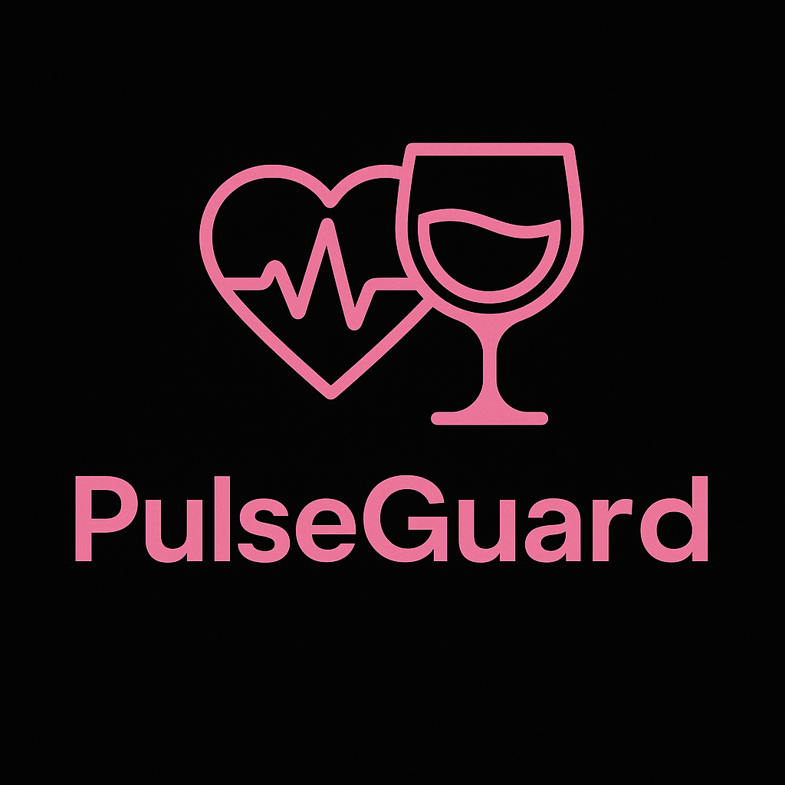
Most safety products wait for the problem
Ours Predicts it
And when danger strikes it responds instantly
Predict. Protect. Prevent

Slide 6
INTRODUCTION
PROBLEM STATEMENT
VALUE PROPOSITION
There is a need for a predictive risk interception system that helps families protect adolescents and young adults from drink tampering.
When teens are out in the world, families lose visibility but not responsibility. We offer a simple promise: detect risk before it happens, detect harm after it occurs, and instantly alert the people who care most.

Slide 7
Patent #1
Nanomaterial sensors
What NASA used it for ?
Originally used for detecting breath based VOC’S-Volatile Organic Compounds (unique gases or chemical footprints emitted from a wide range of everyday products) of the breath to monitor health conditions by analyzing the gas exhaled into the air including disease markers like Covid-19.
Why we Modified it ?
Date-rape drugs don’t release strong gases → hard to detect directly
These reactions release tiny VOCs (e.g., short-chain acids, solvated markers)
Our modified nanosensor reads those signals and converts them into measurable electrical alerts
instead of finding the drug itself, we detect its chemical by-products when it mixes with alcohol or water
How it looks different for drinks?
Sensor scans the air above the drink
Detects subtle chemical changes, not the drug itself
Produces an electrical signal if tampering is detected

Slide 8
Patent #2
Heart Rate Id
What NASA used it for? Biometric authentication: to verify a person’s identity using heartbeat patterns
Secure access: replacement for passwords in computers, labs, and bank systems
High precision: analyzed 192+ Electrocardiogram features (timing, amplitude, vector angles) unique to each person
Goal: confirm who the user is based on the electrical signature of their heart
What we changed for our project? Shifted focus → identity AND safety Questions “Are you in danger?” & Who are you?”
Stress or abnormal heart activity linked to spiked drinks or distress
Combines NASA’s gas sensor (before ingestion) + heart tech (after ingestion) dependant
Still user-specific
Creates a Predictive Risk Interception System — not just security, but life-saving insight

Slide 9
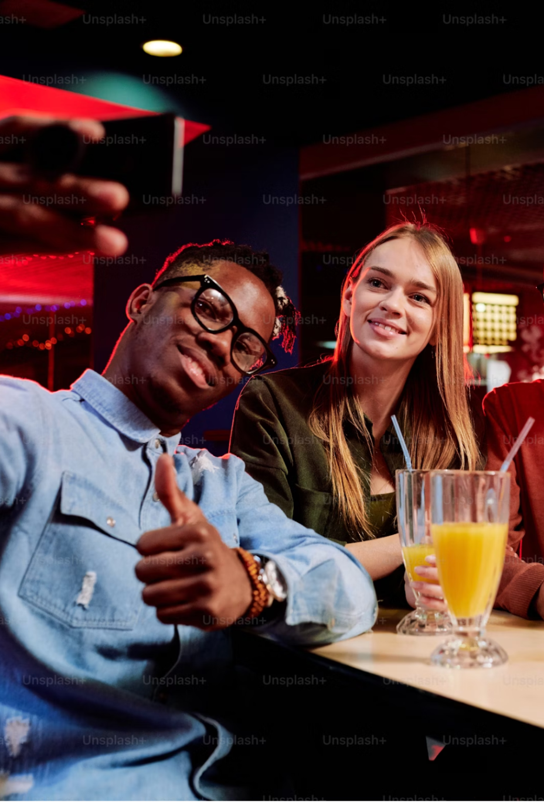
Customer Segments
Students in colleges & universities
Parents and guardians of children between the ages of 14 years - 24 years
Photo Credits: Unsplash

Slide 10
COMPETITION COMPARISON
BRAND | FEATURES | VALUE | PRICING
Xantus | The Drinkcheck™ Wristband tests | Design | $53.99
DrinkGuardian | Drink Cover & Wearable | Special offers | $45.32
Undercover Colors | Nail Polish Test | Reliability | $35-$50
NightCap | Scrunchie Cover | Best Prices | $12
Spikey | Bottle Stopper | Marketing | $6
Think Twice | Spike Test | Customers | $15-$249
Knonap | Covers | Design | $15
Safety Straw | Straw Detector | – | Announced in April 2025

Slide 11
MARKET SIZE OVERVIEW
Total Addressable Market
North America Health & Fitness Wearable Technology Market Size (2024)
$9.79B
Serviceable Addressable Market
$1.37B
Market Size between 14 - 24 years
$41.25M
Serviceable Obtainable Market
1% of the SAM
Notes:
CA Bar Law (AB 1013) Compliant https://www.abc.ca.gov/new-law-requiring-bars-serving-spirits-to-offer-drug-testing-devices-to-take-effect-july-1/

Slide 12
Cost Structure
 | Description | Cost
Manufacturing | Setup production line and quality control. | $200,000
Software | Development of companion app and algorithms. | $145,000
Certification | Acquire regulatory approvals and certifications. | $50,000
Marketing | Brand launch and initial outreach campaigns. | $75,000
Staffing | Recruitment and salaries for key roles. | $500,000
 | Total | $725,000

Slide 13
Revenue Streams
Revenue Streams | Price per unit | Frequency
Wearable Prices | $120 | One-Time Payment
Individual Subscription Plan | $7 | Monthly
Parent Plan | $19 | Monthly
University / Institutional Package Plan for Wearable | $90 | One-Time Payment
Verified Safe Venues Trainings & Certifications | $150 | One-Time Payment
Advertisements | $17.50 | Per number of viewers

Slide 14
PROJECTIONS
PRODUCT | UNITS | REVENUE
Wearable Prices | 4000 | $480,000
Individual Subscription Plan | 4000 | $28,000
Parent Plan | 4500 | $85,500
University / Institutional Package Plan for Wearable | 2000 | $180,000
Verified Safe Venues Trainings & Certifications | 10 | $1,500
Revenue: $775,000 Cost: $725,000 Profit: $50,000

Slide 15
ORGANIZATIONAL CHART
Raquel
CEO
—
Product Manager
Wambui
Chief Financial Officer
Dubem
Lead Software Developer
—
Product Designer
—
Operations Lead
—
Marketing Analyst
—
Data Analyst
—
Tech Fellow
—
Intern
—
Fellow
—
Intern

Slide 16
TIMELINE
Conduct market research
Prototype Development
Pilot Testing & Iteration
Pre-Launch & Regulatory Prep
01.
02.
03.
04.
05.
06.
07.
08.
Market Launch
Growth & Expansion
Data & Impact Optimization
Exit Strategy

Slide 17
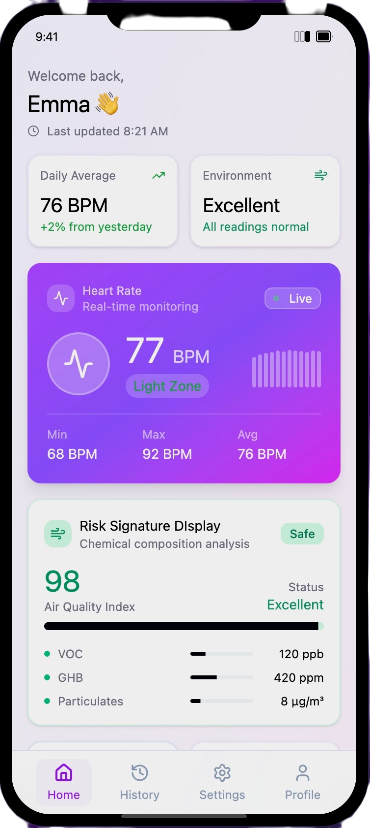
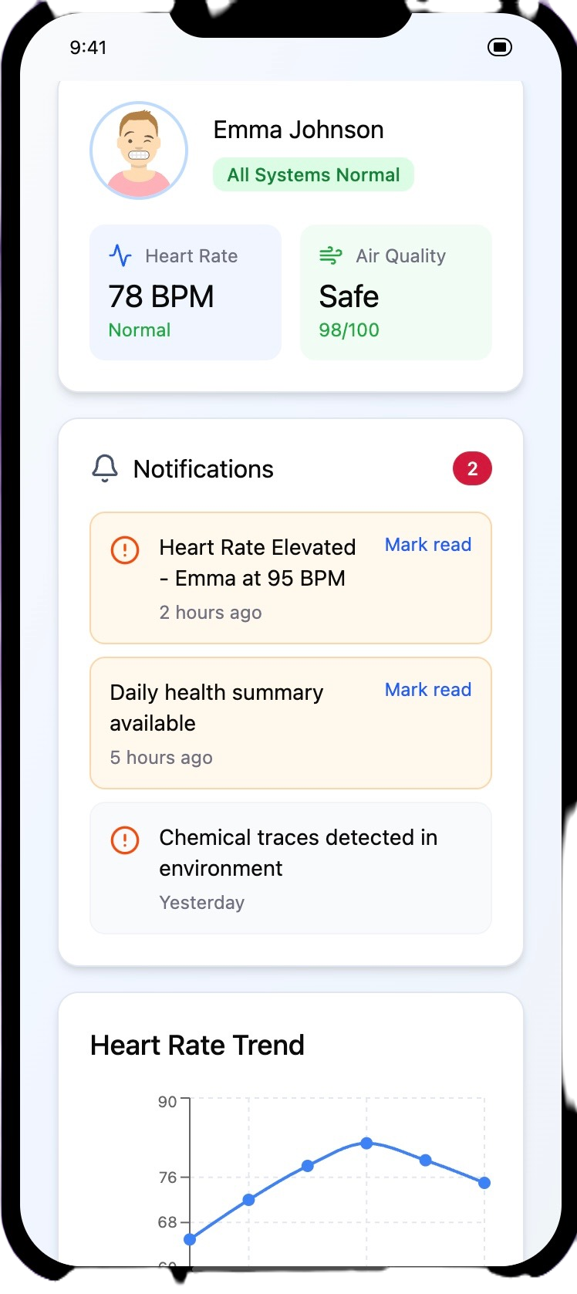
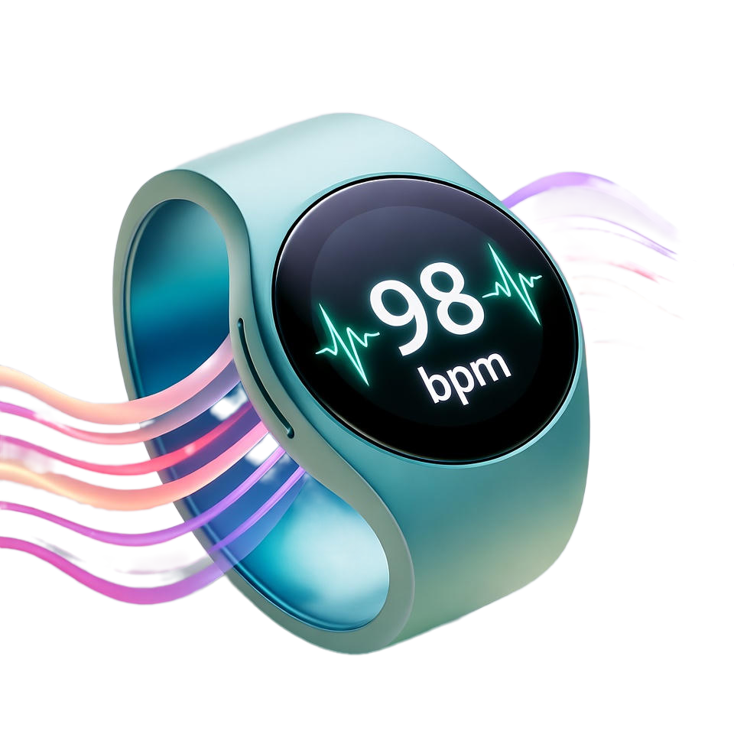
User Interface
https://lunatek.netlify.app/

Slide 18
SUMMARY
PulseGuard is developing the first Predictive Risk Interception System designed to help families protect teens and young adults (ages 14–24) from drink tampering and spiking incidents.
This product:
New: The first solution to combine real-time detection, predictive risk alerts, and post-incident analysis in one seamless platform.
Relevant: Addresses a growing safety concern among students, nightlife participants, and parents, providing peace of mind and immediate visibility.
Market Opportunity: Serves a large and underserved market spanning colleges, bars, and family safety tech — with strong potential for national and global adoption.

Slide 19
THANKS!
Do you have any questions?
info@pulseguard.io
+1 470 555 5555
https://lunatek.netlify.app/

Slide 20
Appendix
Financials
Market Share Data
Business Model Canvas

